Slide 1

EXPLORATORY DATA ANALYTICS
STERLING E-COMMERCE COMPANY

Slide 2


Outline
Project recap
Problem
The Analytics team
Process
Insights
Interpretation
Recommendations
Summary

Slide 3

Project Recap
Data analytics for better scaling of an e-commerce business

Slide 4

Problem
Challenges extracting meaningful insight from the company’s data

Slide 5
Maureen
Principal Data Scientist
Williams
Data Scientist
The Analytics team
Joram
Data Scientist
Damilola
Data Scientist
Emmanuel
Data Scientist
Vivian O. Oguadinma
Data Scientist

Slide 6

Process
Data cleaning
1
Data Future Engr.
2
Data exploration/Interpretation
3
Data visualization
4
5
Data storytelling

Slide 7
INSIGHTS
MONTH WITH THE HIGHEST REVENUE
DECEMBER
TOP CATEGORIES BY ORDER
MOBIL’S & TABLETS (47.1%)
GENDER WITH THE HIGHEST TRANSACTION
MALE (50.97%)
GENDER WITH THE HIGHEST REVENUE
FEMALE
BEST PAYMENT METHOD
COD (40.15%)
MONTH WITH THE HIGHEST ORDER
DECEMBER
TEXAS
SOUTH
State with the highest order and revenue
The region with the highest order and revenue

Slide 8
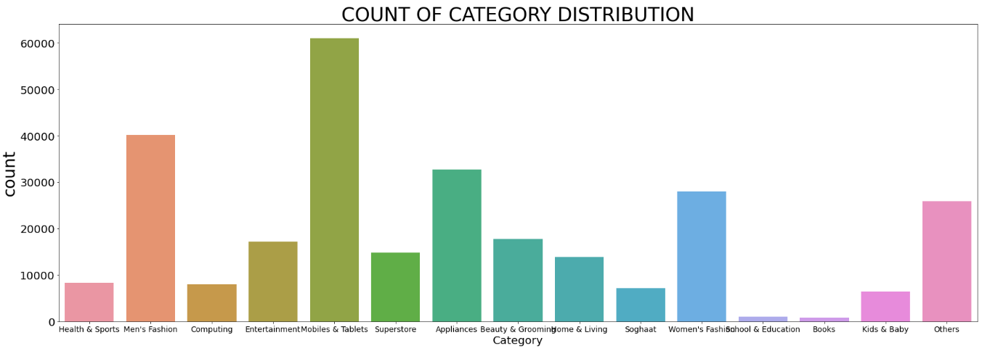
DATA INTERPRETATION

Slide 9
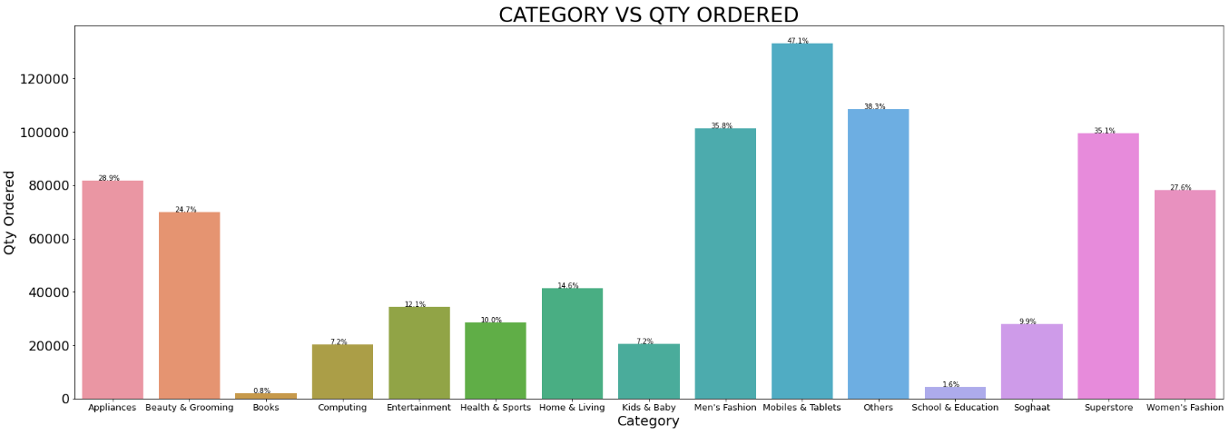
DATA INTERPRETATION

Slide 10
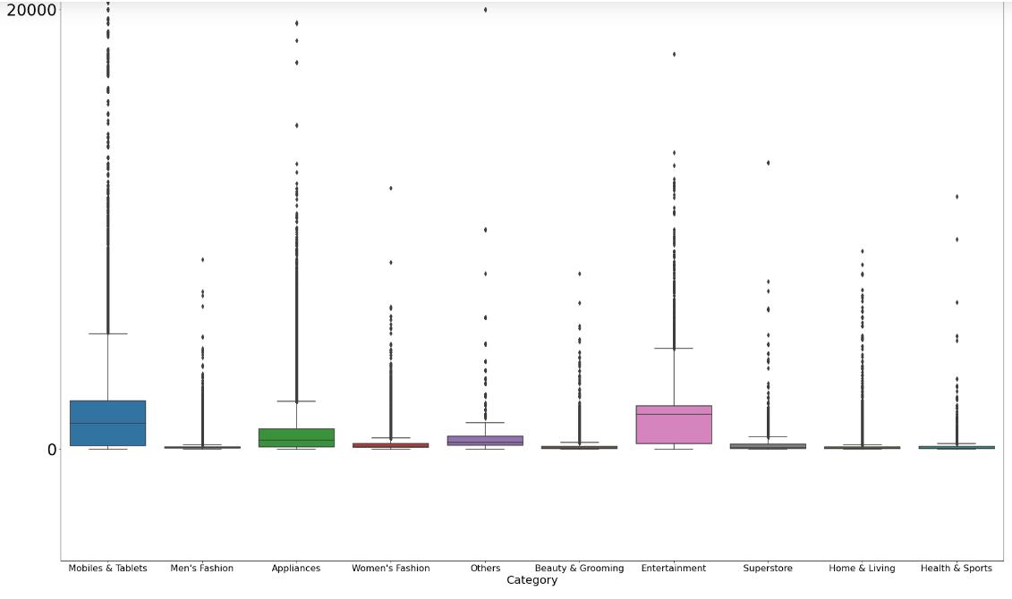
DATA INTERPRETATION
CATEGORY VS REVENUE
MOBILE & TABLETS
ENTERTAINMENT
APPLIANCES
Revenue

Slide 11
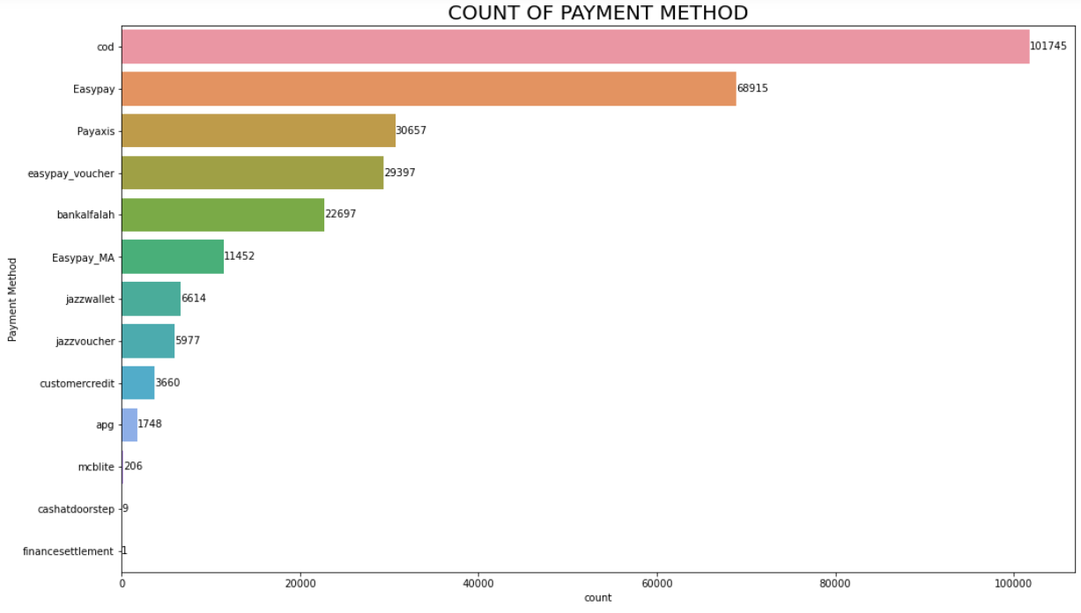
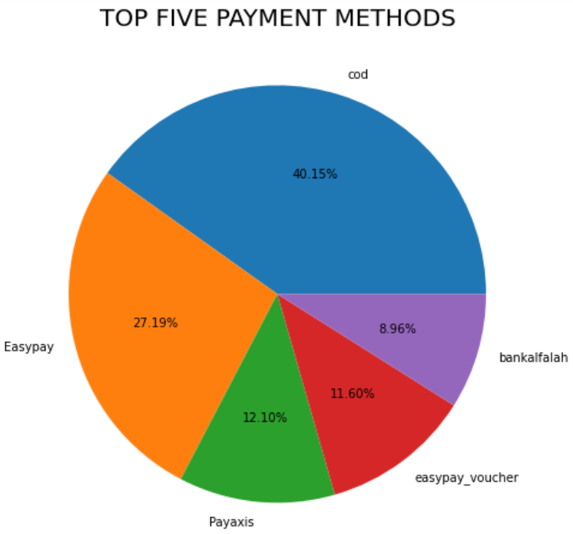
DATA INTERPRETATION

Slide 12
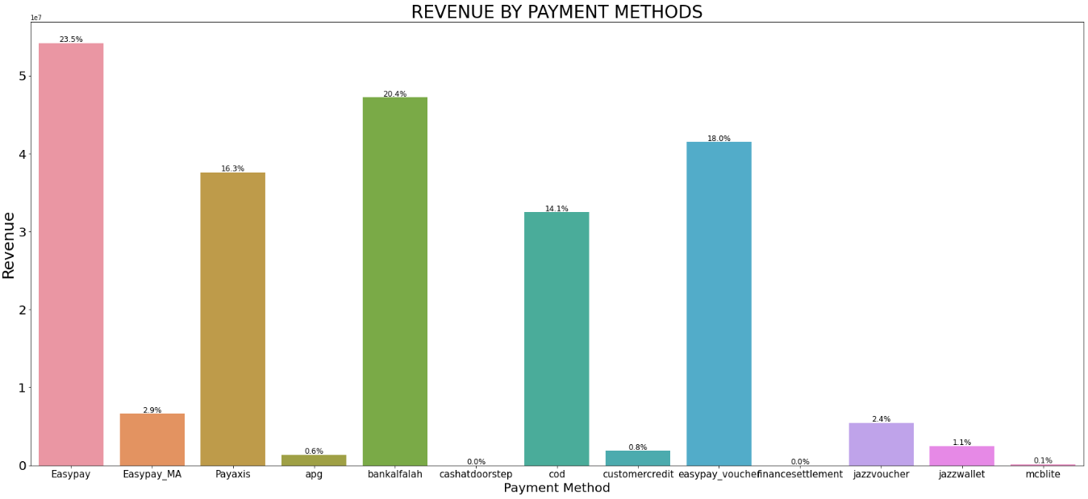
DATA INTERPRETATION
Easypay = 19142.5%

Slide 13
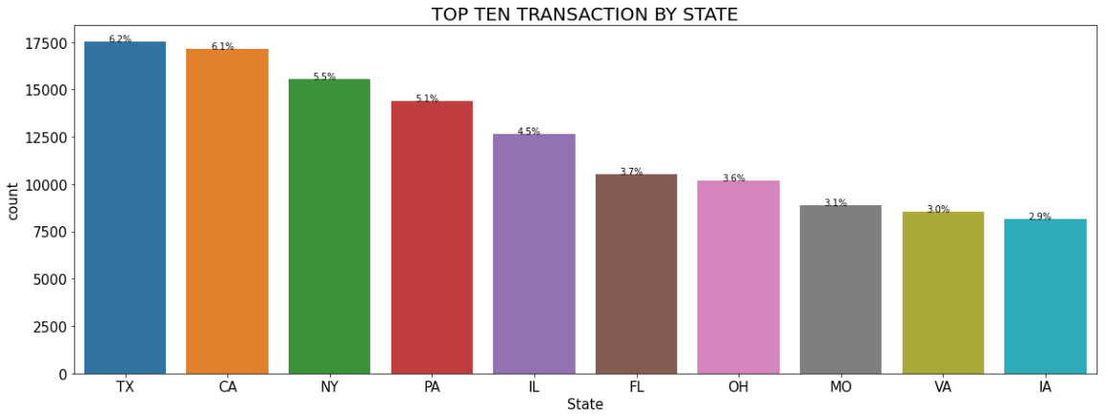
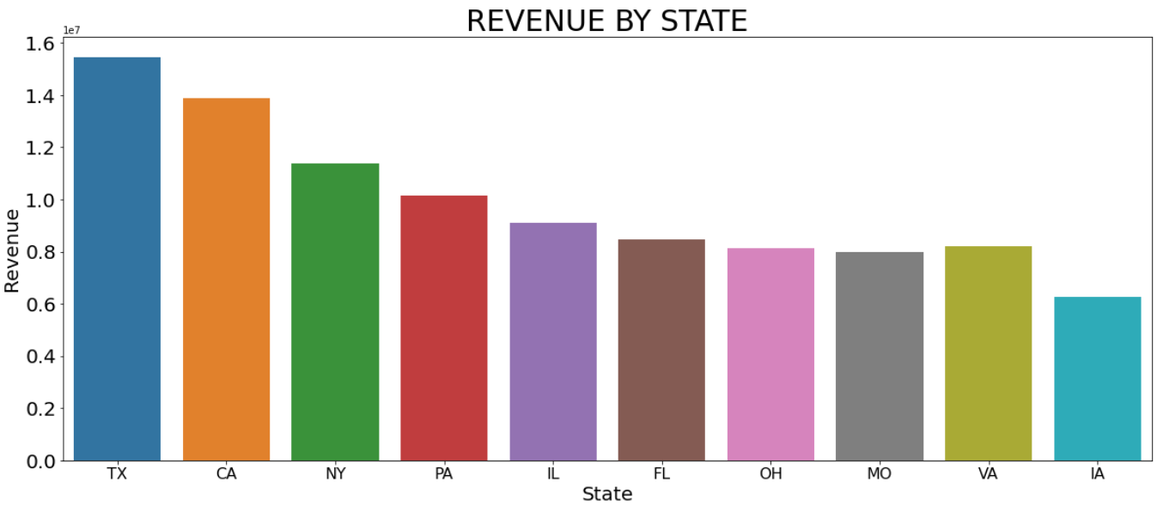
DATA INTERPRETATION
TX = 6.2%

Slide 14
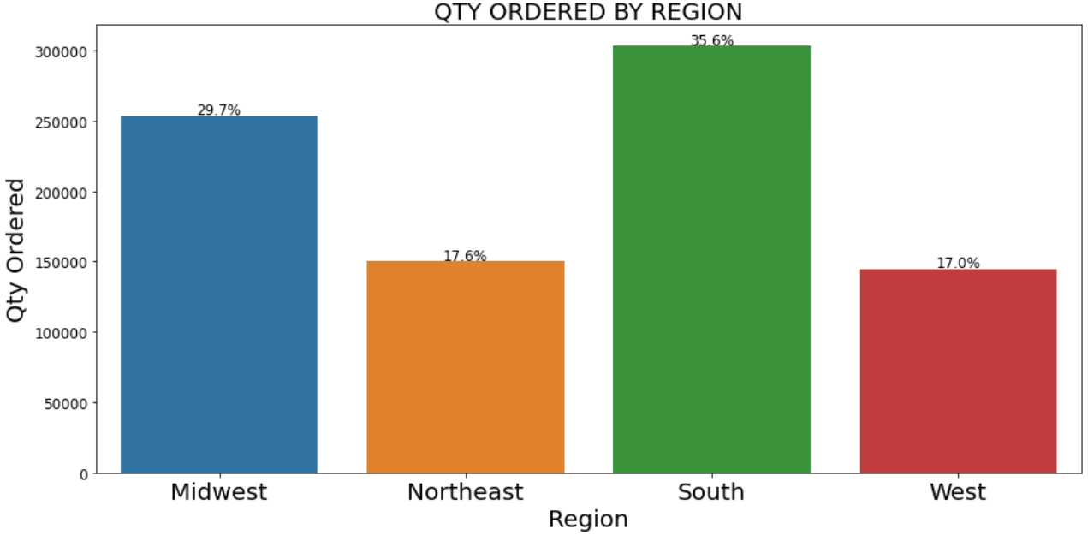
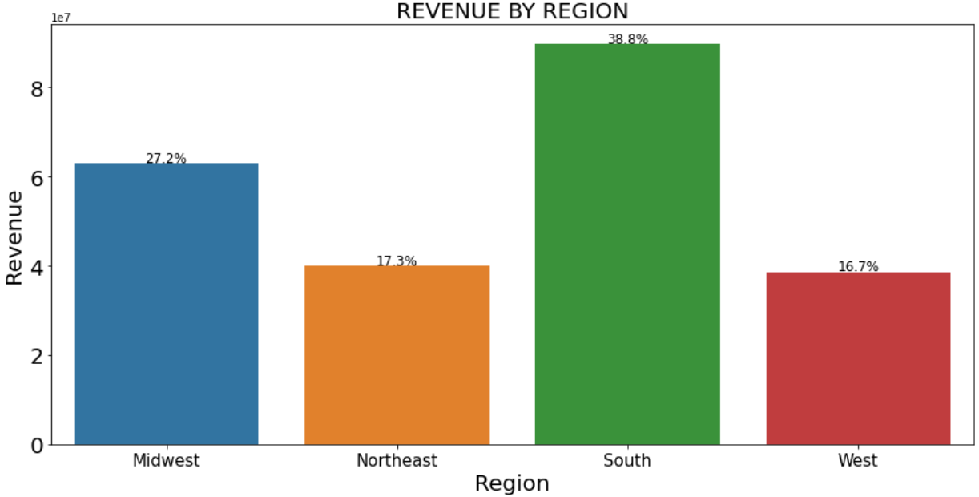
DATA INTERPRETATION

Slide 15
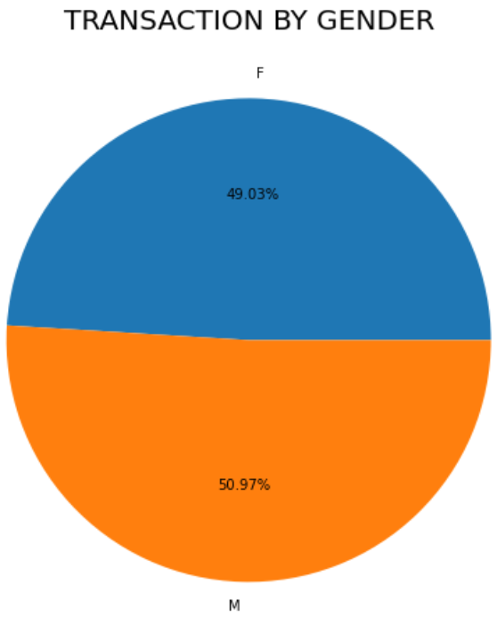
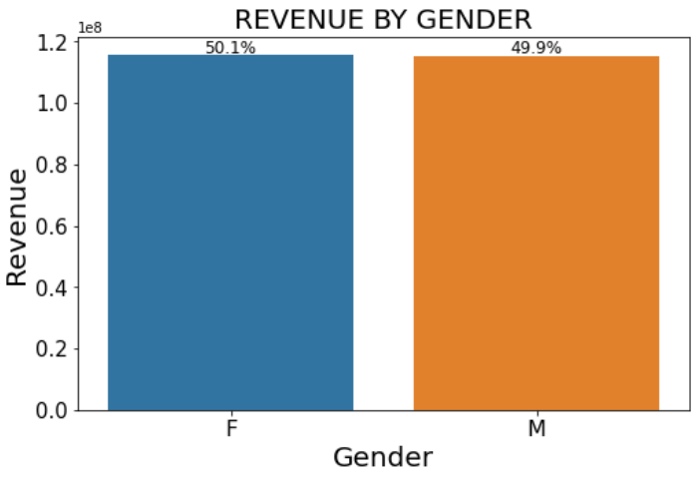
DATA INTERPRETATION

Slide 16
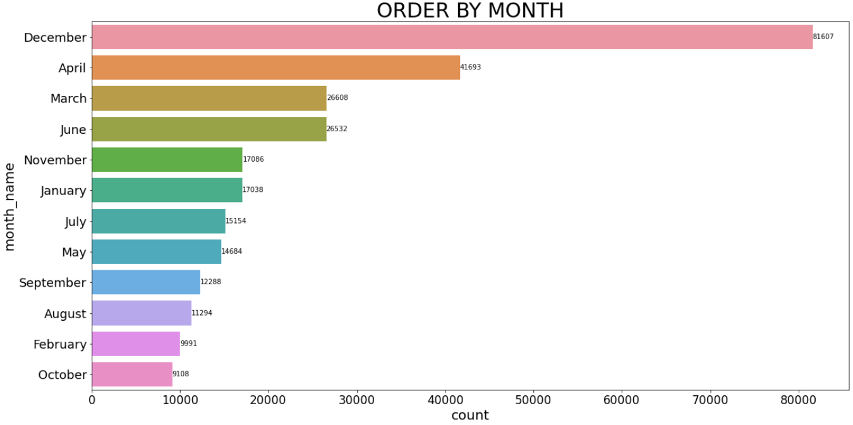
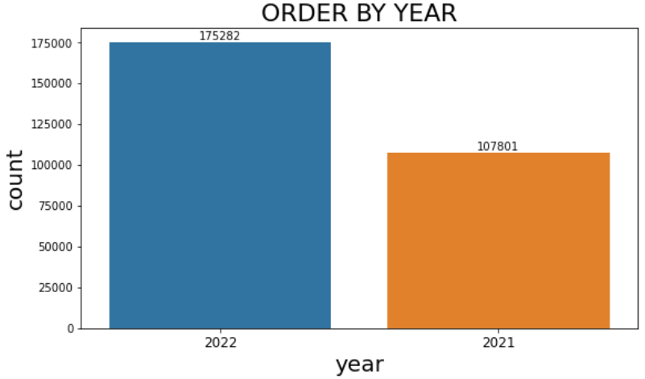
DATA INTERPRETATION: Time Analysis

Slide 17
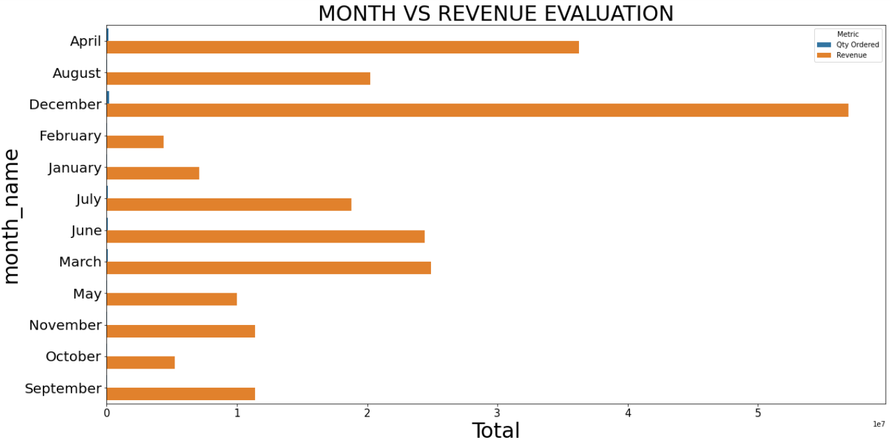
DATA INTERPRETATION: Time Analysis

Slide 18
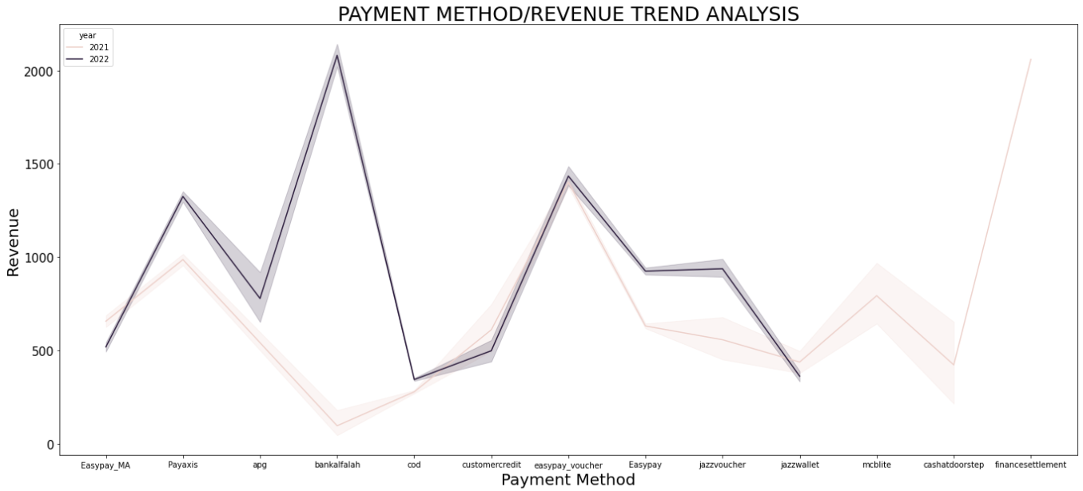
DATA INTERPRETATION: Time Analysis

Slide 19
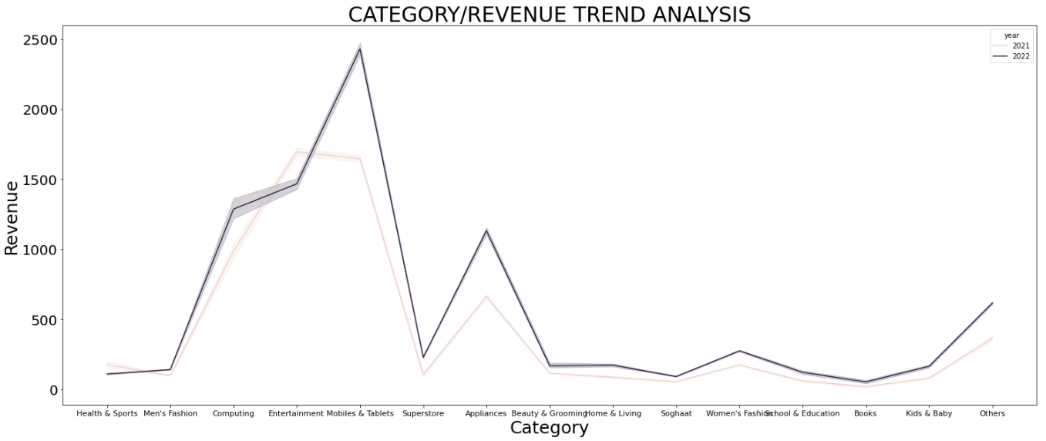
DATA INTERPRETATION: Time Analysis

Slide 20
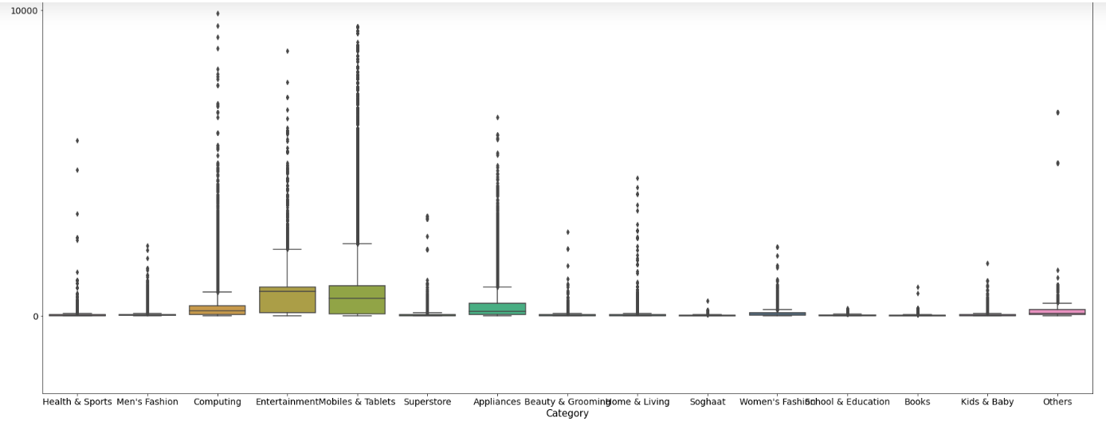
DATA INTERPRETATION
UNIT PRICE VS CATEGORY
Unit_Price

Slide 21
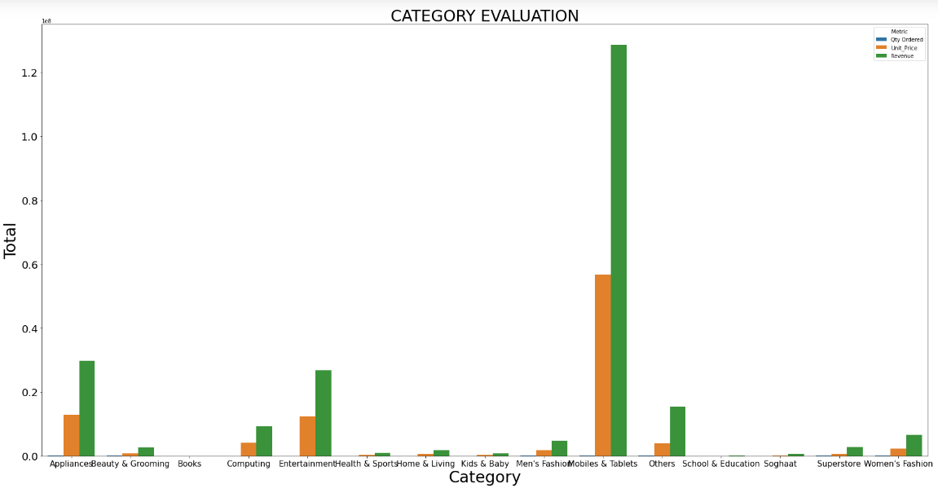
DATA INTERPRETATION

Slide 22
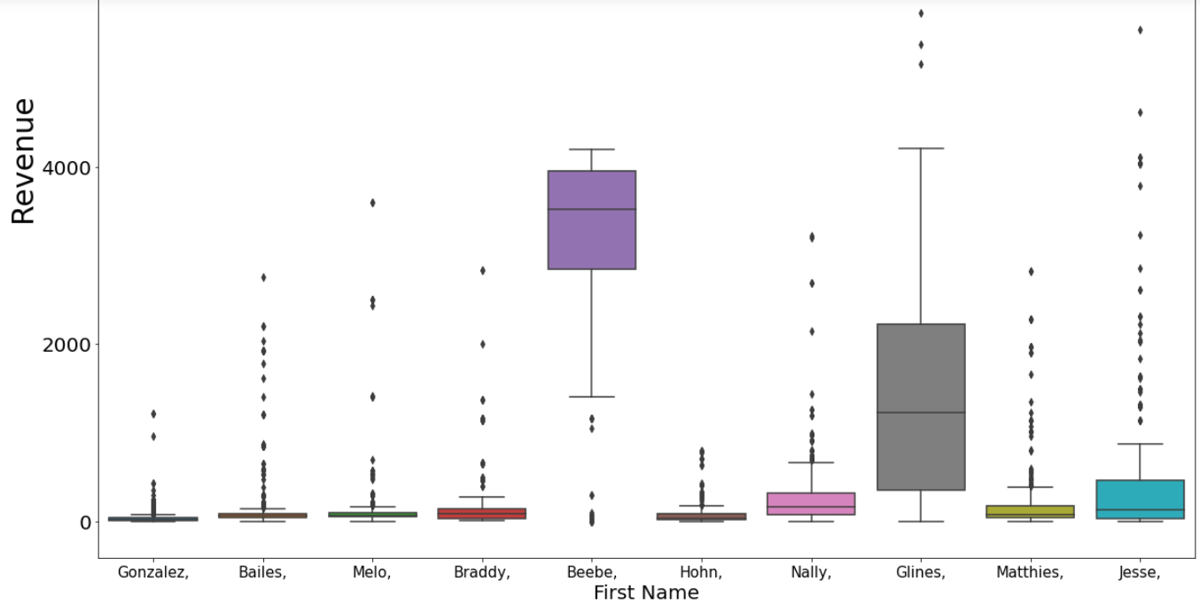
DATA INTERPRETATION
TOP TEN CUSTOMER VS REVENUE

Slide 23
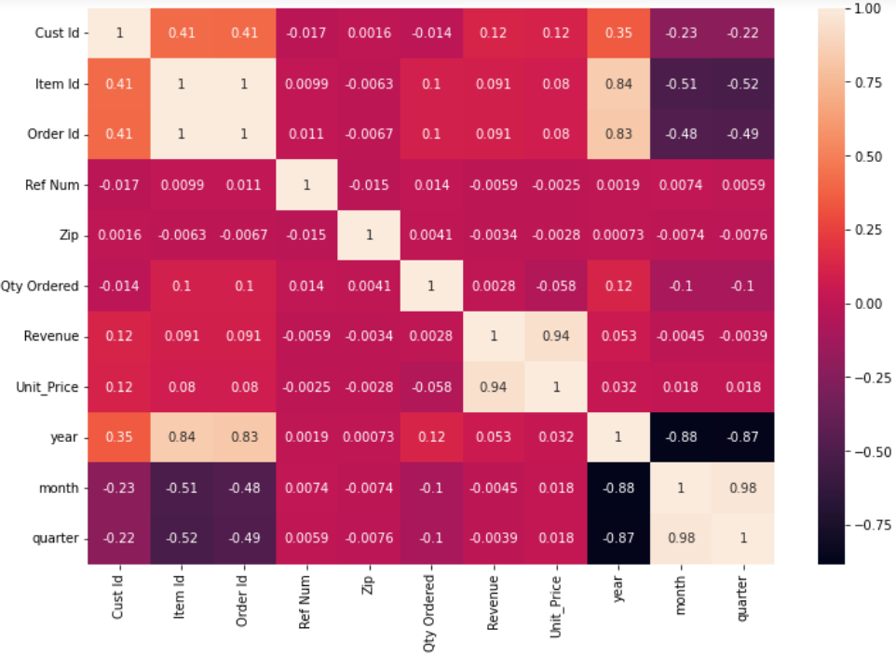
DATA INTERPRETATION: Correlation Analysis

Slide 24


Summary
Analysis
Sterling E-commerce company is an online business that needs thorough insight into its customer data to effectively scale its business. A sales table containing 15 product categories and 13 payment methods along with other variables was available for this study.
Insights and Recommendation
The users are more inclined towards Mobile & Tablets, Men’s fashion, Appliances, and Superstore products with books and school products as the least desired. The most qty ordered and highest revenue is observed in December and April. Col and Easypay are the most preferred in terms of product order and revenue generation respectively. Beebe, Glines, and Jesse are the top 3 performing customers.
Although the male gender seems to make the most purchase the females turn in greater revenue for Sterling e-commerce. It was noted that more orders were placed in the year 2022, and this complements the surge in the use of payment methods in the same year.
To boast unpopular payment method usability, increase the order of the least desired product category, and maximize revenue, it is recommended that the campaign be built around the payment methods, Books, and schools products. Using the discount implementation strategy, new customers could be won over while old customers could make more purchases.
Moving forward, it is advised that the purchase table including cost variables be made available for effective profit calculation. This will provide insight into which product performs better than the other.

Slide 25

Thank you!
ANY QUESTIONS?

